Slide 1
CryptoGear
Team Members
Jose Canizares
Raymond Duncan
Sayed Sarder
Anh-Khoa Than

Slide 2
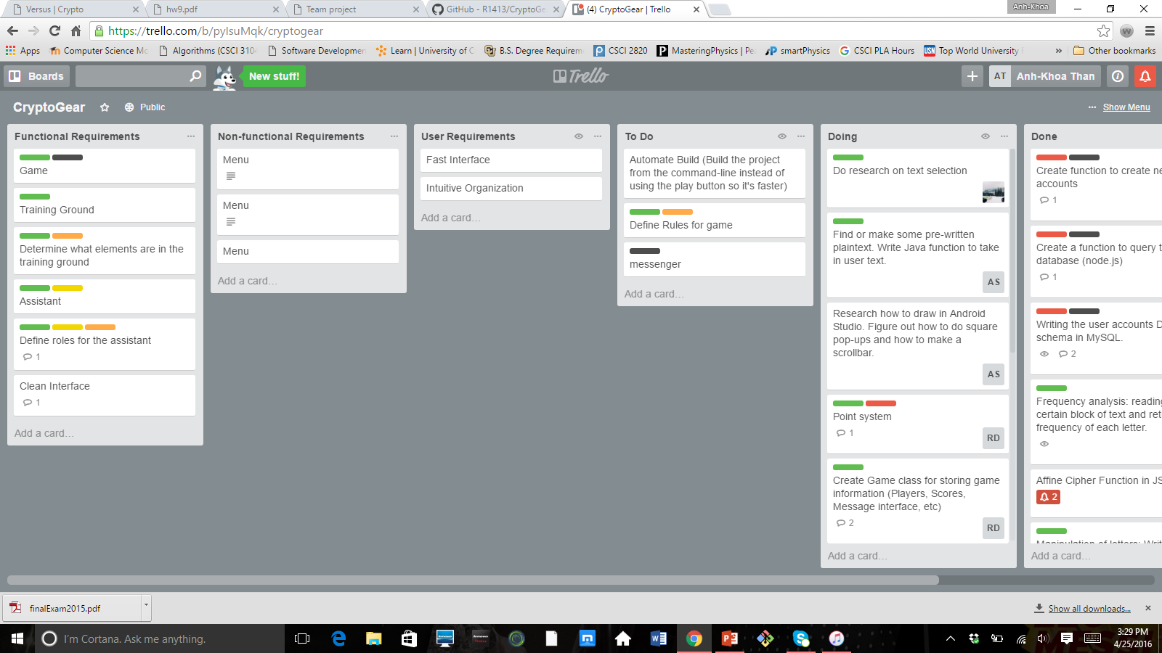
Trello
Over the course of the project, we used Trello as a tracking tool.
Pros: Helps organize ideas and tasks needed to be done; keep track of deadlines for each phase of the project.
Cons: Needs to be updated constantly; does not have deadline reminder.
Rank: 4/5

Slide 3

MYSQL
We used MYSQL to store all the game database, such as login information, friends, and messages.
Pros: Stores all vital database elements; able to change and update as frequent as needed.
Cons: Stability Issues; sometimes lagging.
Rank: 4.5/5

Slide 4
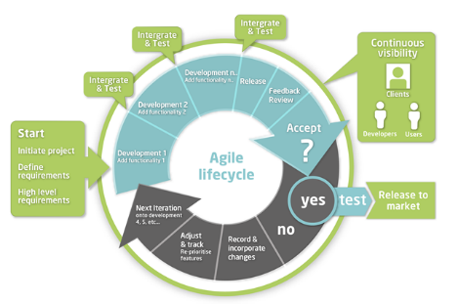
Agile Methodology
As a team, we took full advantage of Agile Methodology throughout our project. Besides the traditional project management in Agile styles, by using this methodology, we were able to make sure the transition from developing an Android App as an initial goal, to making a website, as smooth as possible with minimal disruptions to our ideas.
RANK: 5/5

Slide 5
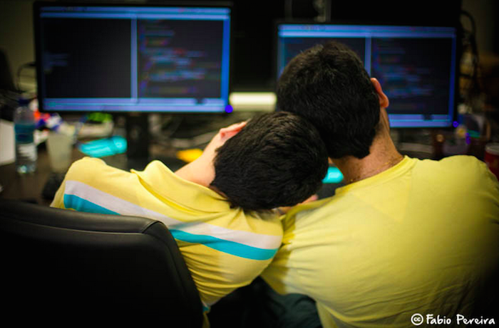
PAIR PROGRAMMING
Our team implemented the idea of pair programming. We pair programmed in every way as needed, besides sitting next to each other, we also took advantage of video softwares such as Skype and Facebook Video to read/check each other’s code.
RANK: 5/5

Slide 6


Challenges
Most of team members are new to website development; HTML, CSS, JAVASCRIPT, PHP, ETC.
Solutions to solve challenges faced along the way: watch tutorial videos, read and doing exercises about HTML and CSS online, learn lectures about website development provided by a friend from his University of Washington school.

Slide 7
DEMO
LINK TO OUR WEBSITE: http://crypto.vivoapplications.com/

